Slide 1



Team Agile Robotic Control
Logan Beaver - ME
Justin Campbell - ME
Tyler Paddock – CE
Ronald Shipman – ME
Dr. Luis Rodriguez – advisor

Slide 2
Project Overview
Develop initial robotics platform
Public Outreach
Increase interest in STEM fields
Engineering deficit
Fluid Power
Educational robotics platform
Fluid Power
Control Systems
Robotics
Iterated by future teams

Slide 3
Major Design Decisions
Quadruped Locomotion
Agile motion
Dynamically stable
Rugged terrain capability
Pneumatic Actuators
High energy density
Clean and lightweight
Compliant action

Slide 4
Major Constraints and Objectives
Maximum weight of 35 kg
Top speed of 0.5 m/s
Implementation of drag gait
Easily accessible emergency stops
3 Hour Battery Life
Onboard batteries and control systems
Tethered air supply with additional onboard storage space

Slide 5
Simulation and design
Dynamic simulations were used to design the initial robot
Torque analysis for pneumatic actuator design
Force analysis for mechanical design
Kinematic simulation for control system design

Slide 6
Simulation and design
Derived from initial kinematic equations
Put in state matrix form
Kinematic simulation used to get robot state at different positions
Required forces and torques determined from robot state

Slide 7
Pneumatic design
Eight two directional valves, two for each leg
Eight 4/3 solenoid directional control valves
Soft start/dump solenoid valve
Controlled with Arduino Mega microcontroller running Simulink

Slide 8
Pneumatic construction
Insert pictures here

Slide 9
Mechanical system
Chassis constructed from 20mm, 80/20 extruded aluminum
Aluminum plate added to bottom to allow for component placement
Legs are made out of 6061-T5 Aluminum
Bearings placed at each hip and knee joints to improve motion

Slide 10
Current Chassis Construction
Add chassis picture

Slide 11
Current Leg Construction
Add full leg picture

Slide 12
Electrical design
DC valves require 24v power and two 10v command signals
Amplifier requires + and – negative rails to perform signal conditioning
Switch Capacitor Voltage Converter circuit provides negative rail
Cylinder Position Feedback is a Linear Resistive Transducer
9v power supply to Arduino Mega and 30 volt supply for the valves
Debug panel
Battery indicator LEDs
Banana plugs for compatibility with MSOE lab equipment
Emergency Stop

Slide 13
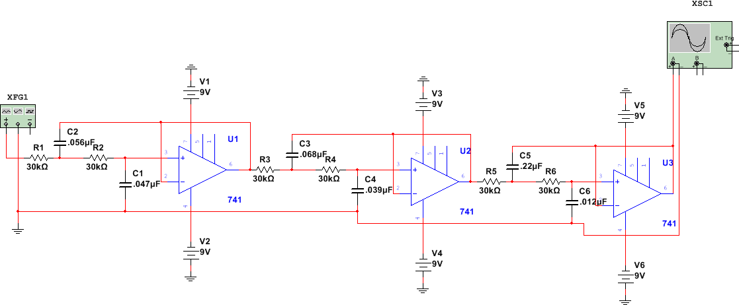
Arduino Mega PWM to Analog
Third Order Sallen-Key Low Pass Filter

Slide 14
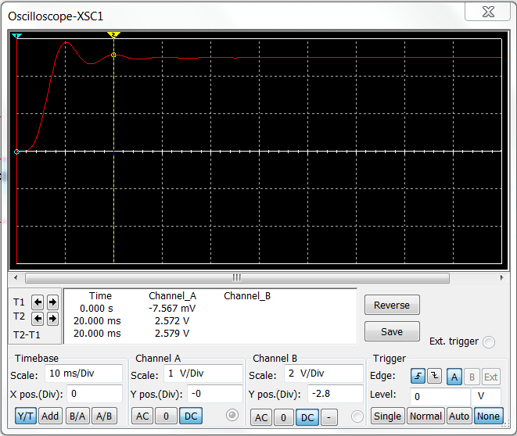
Filter Response
Higher order filter was used to get a smooth response
Third order filter was selected to maintain fabrication simplicity

Slide 15
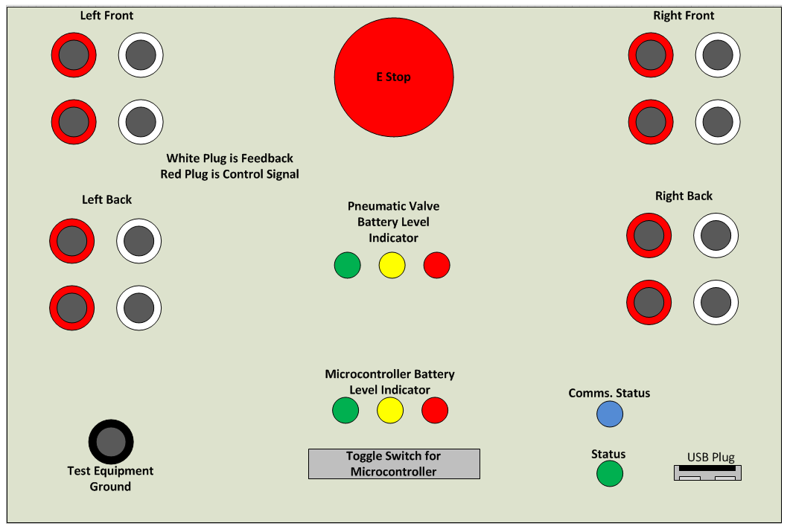
Debug Panel Layout
USB Plug: Program with disassembly
Emergency Stop: Removes valve power
Banana Connections: Each leg’s control signal is accessible
Comms. Status LED: Indicate communication system connection
Status LED: Indicate status states in the software

Slide 16
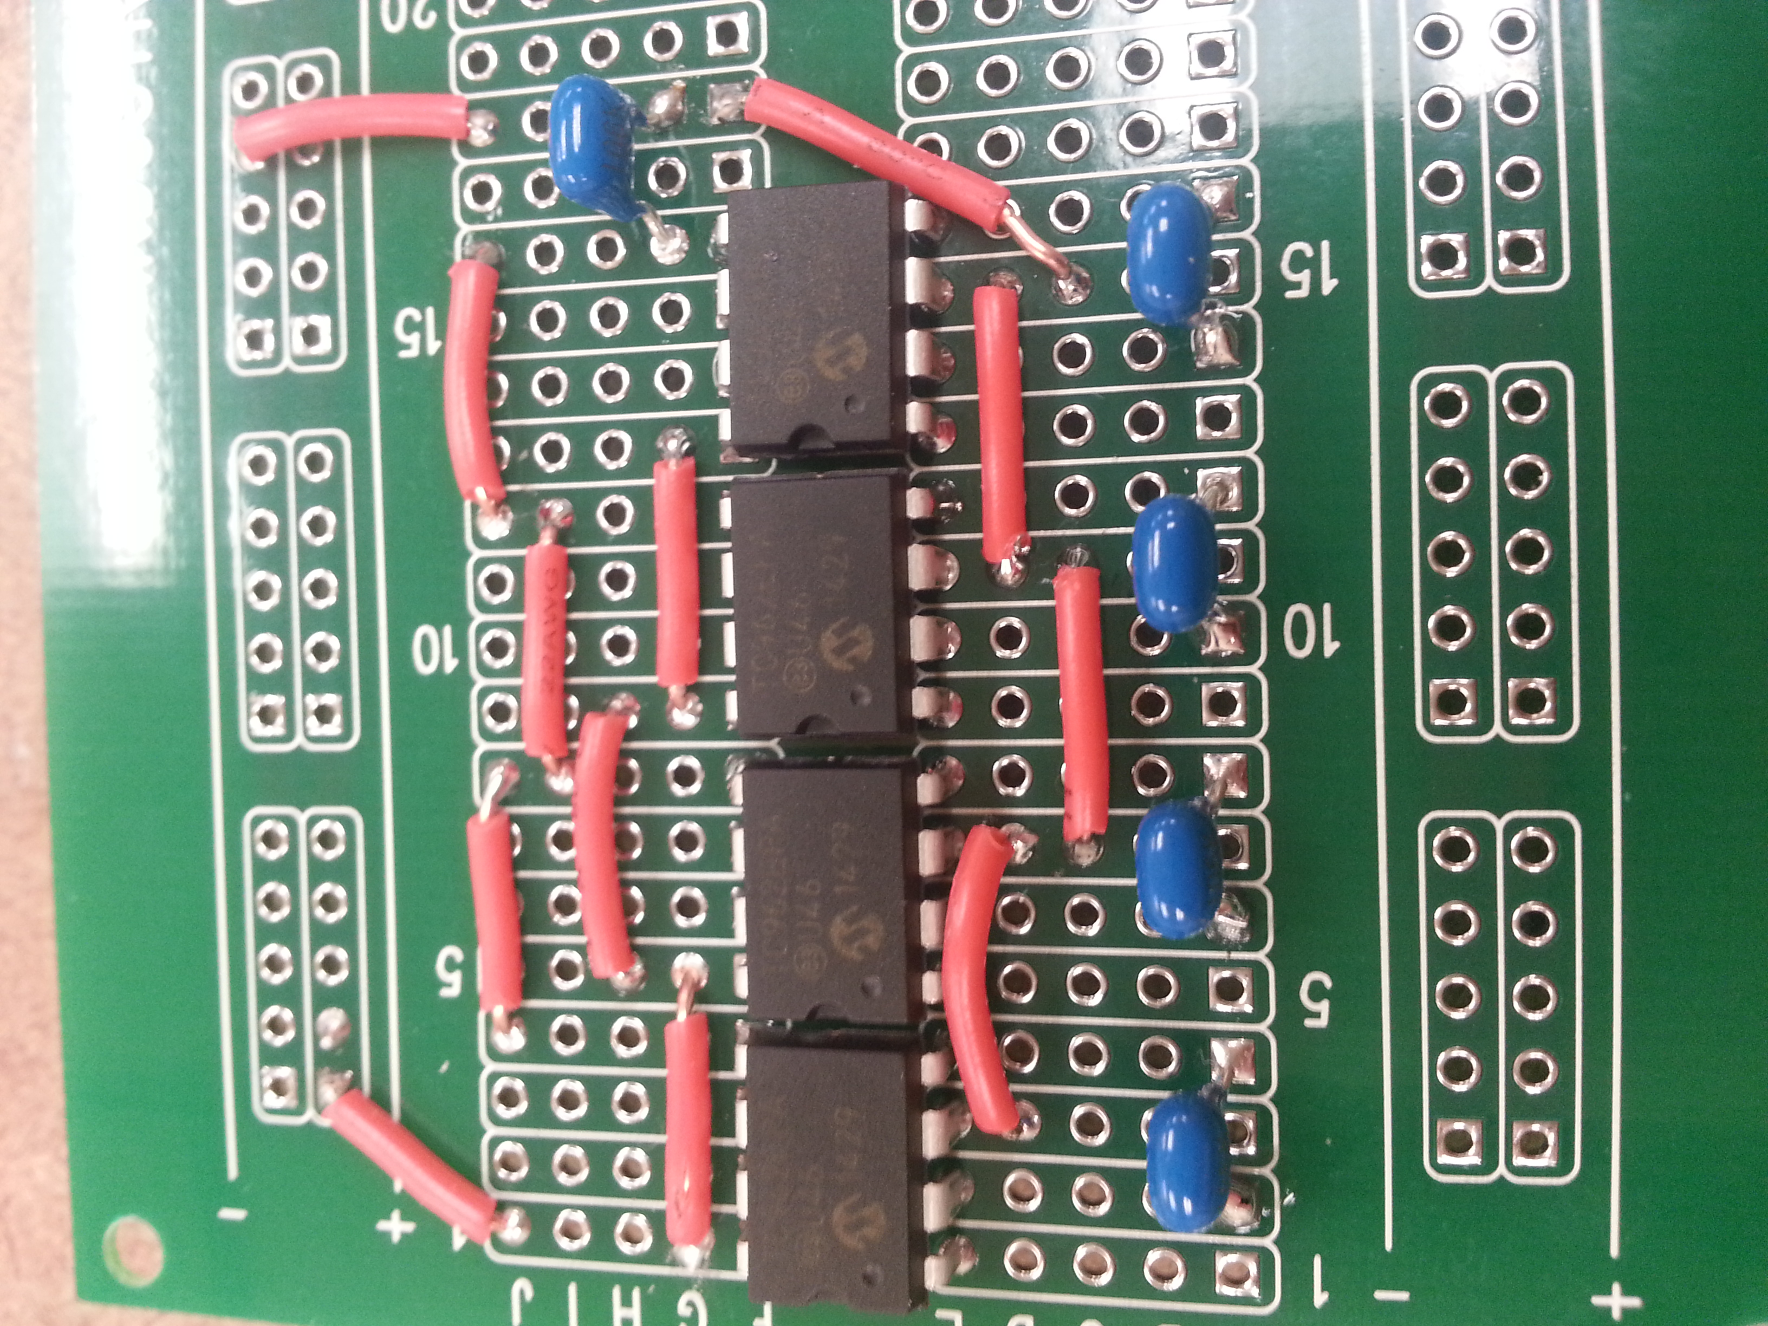
Switched Capacitor Voltage Converter
Notice the breadboard style PCB board
Disadvantages:
Soldering the connections
Not as clean as a custom PCB board
Advantages:
Modifications are possible for future teams
More secure than breadboard prototyping
Low cost (several dollars per board) vs, custom design runs

Slide 17
Control scheme
Code generated from Simulink model
Simulink uses a Stateflow diagram to control foot position based on user input
User controls microcontroller via joystick with a custom java HMI through a wireless zigbee communicator
Currently uses a lookup table with index to determine next foot position
Delays next command until voltage is within a threshold

Slide 18
Control scheme
Insert diagrams here

Slide 19
What’s Next?
Finish robot leg assembly
Integrate pneumatic components with robot chassis
Configure control scheme to consider a full leg
Create final motherboard circuit
Finish debug panel construction
Implement drag gait
Ensure documentation is clear and complete for next year’s groups

Slide 20
Questions?

